Slide 1
What is TypeScript, and Should You Care?
TJ VanToll
Notes:
This is a simple title slide; you can customize if you’d like.

Slide 2
How big was MSU’s first graduating class (1861)?
7

Slide 3
TypeScript
Triple-Slash Directives
Declaration files
Namespaces
Structural detection
Classes
Compiler options
Type Inference
Modules
Generators
Declaration merging
Decorators
Generics
Mixins
Sequential piping
Symbols

Slide 4
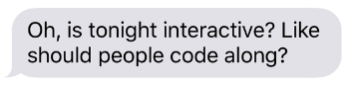
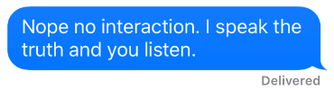

Slide 5
TypeScript
Triple-Slash Directives
Declaration files
Namespaces
Structural detection
Classes
Compiler options
Type Inference
Modules
Generators
Declaration merging
Decorators
Generics
Mixins
Sequential piping
Symbols

Slide 6
“A typed superset of JavaScript that compiles to plain JavaScript”

Slide 7
“A typed superset of JavaScript that compiles to plain JavaScript”

Slide 8


Slide 9
“A typed superset of JavaScript that compiles to plain JavaScript”

Slide 10


Slide 11
😍

Slide 12
😠

Slide 13
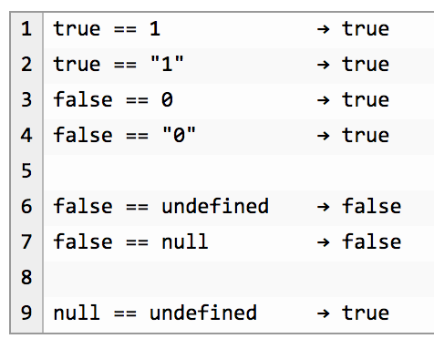

Slide 14
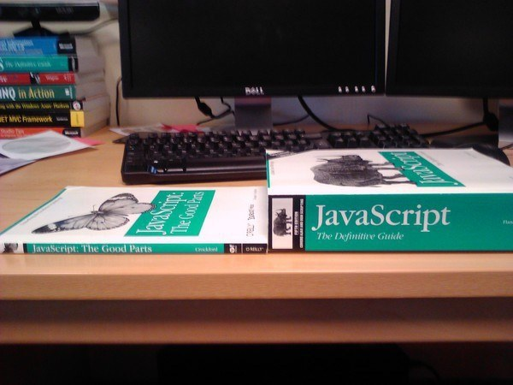
Notes:
34

Slide 15
Compile to JavaScript tools
There are a lot.
345
Source: https://github.com/jashkenas/coffeescript/wiki/List-of-languages-that-compile-to-JS
Ruby, Python, Erlang, Java, Scala, C#, F#, Lisp, Scheme, Haskell, Smalltalk, C, C++, Basic, Go, PHP, and way more.

Slide 16
Fun names of compile-to-JS tools
treehugger
jangaroo
Waterbear

Slide 17
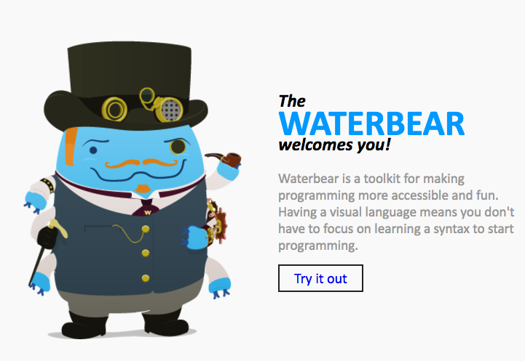
http://waterbearlang.com/

Slide 18
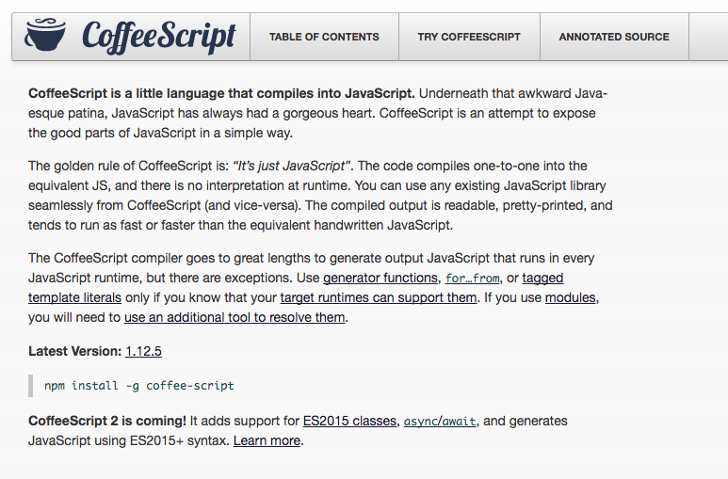
Notes:
2009

Slide 19
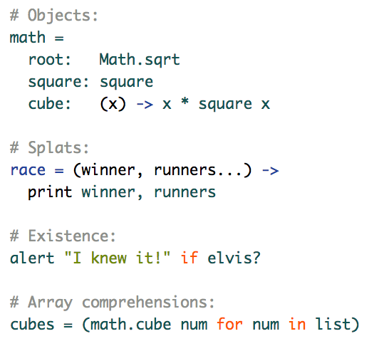

Slide 20
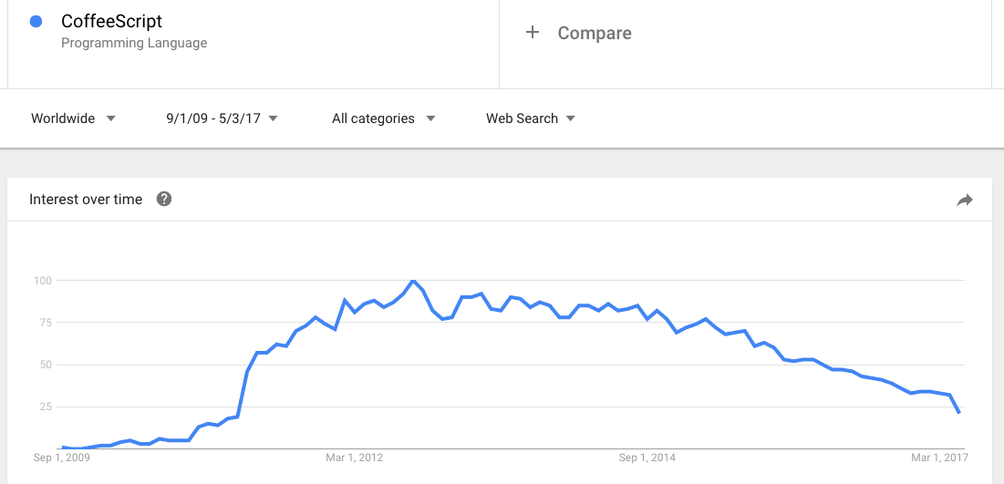

Slide 21
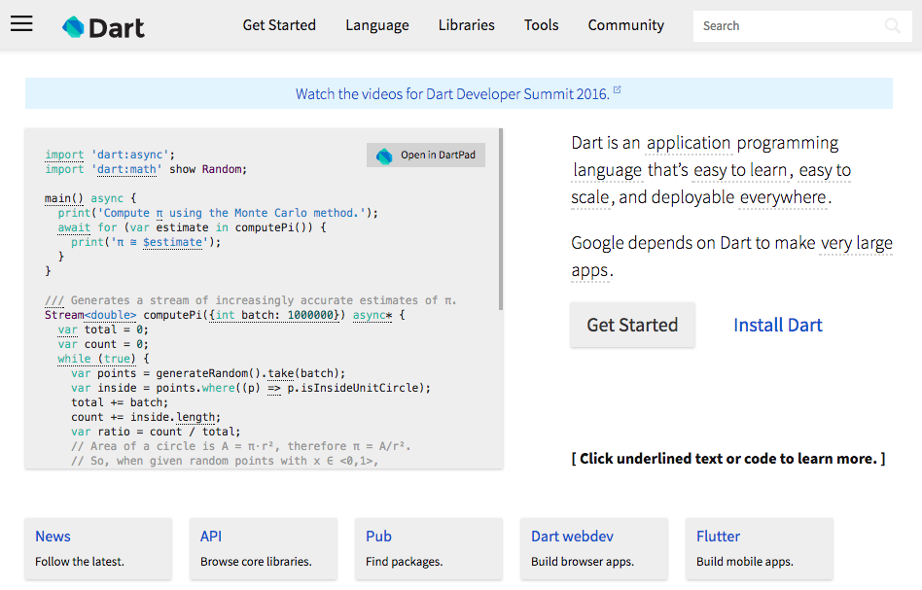
Notes:
2011

Slide 22
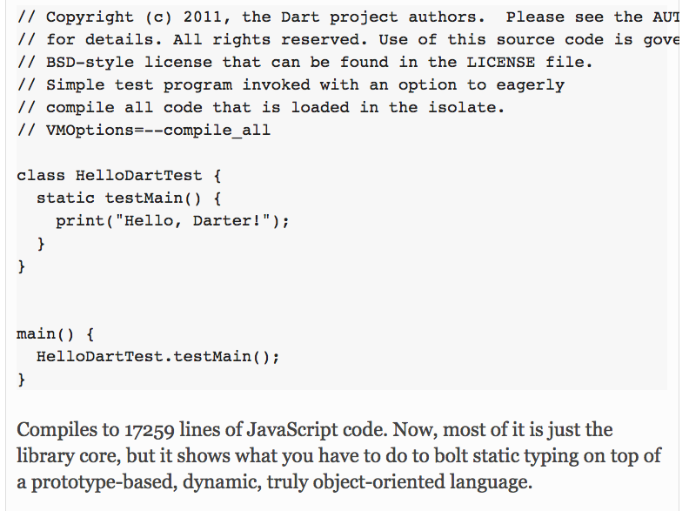

Slide 23
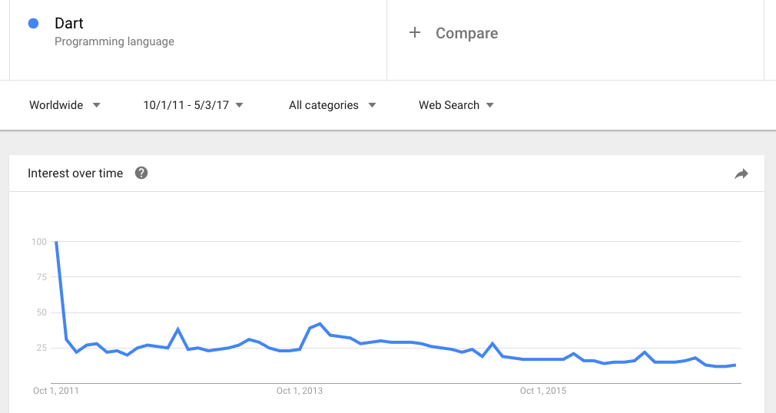

Slide 24


Slide 25
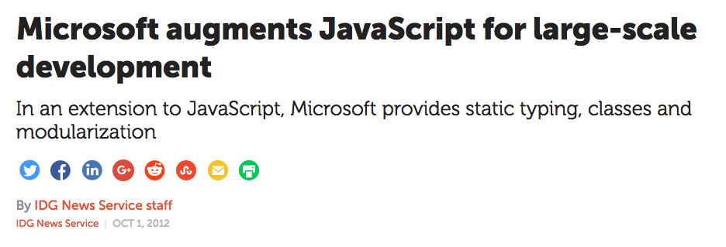
Notes:
October 2012

Slide 26
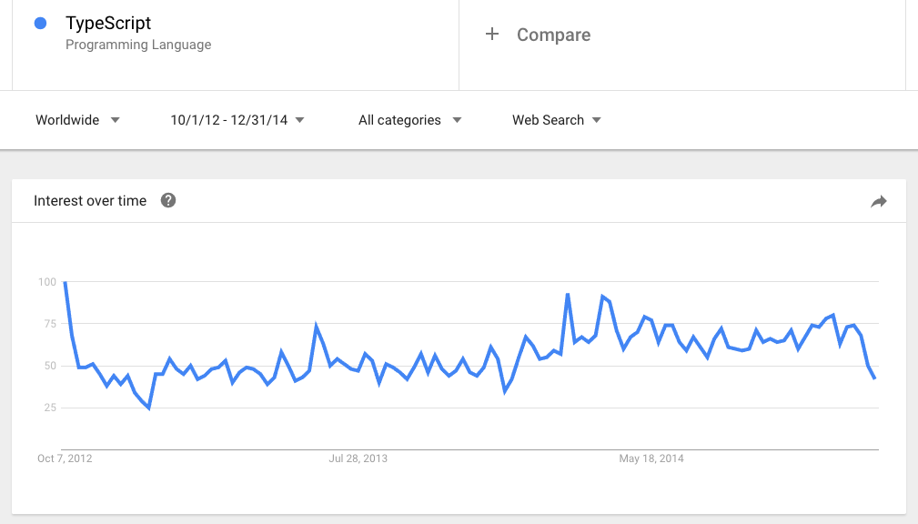

Slide 27


Slide 28


Slide 30


Slide 31


Slide 33
“We risk a lot by building our core on top of TypeScript.”

Slide 34
“I don’t hear anyone talking about TypeScript.”

Slide 35
“I like to keep my JavaScript pure, as God intended.”

Slide 36
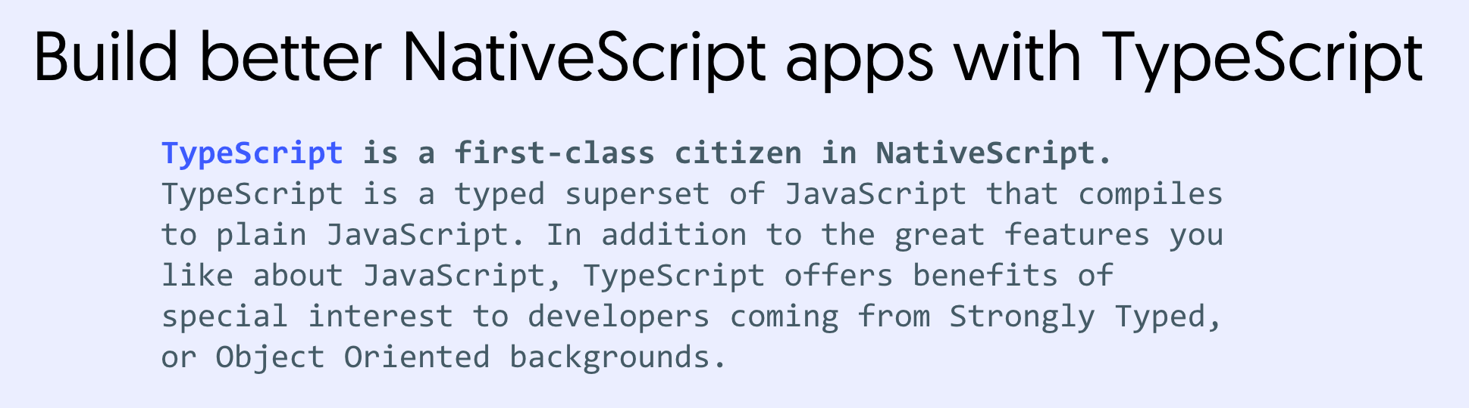

Slide 37
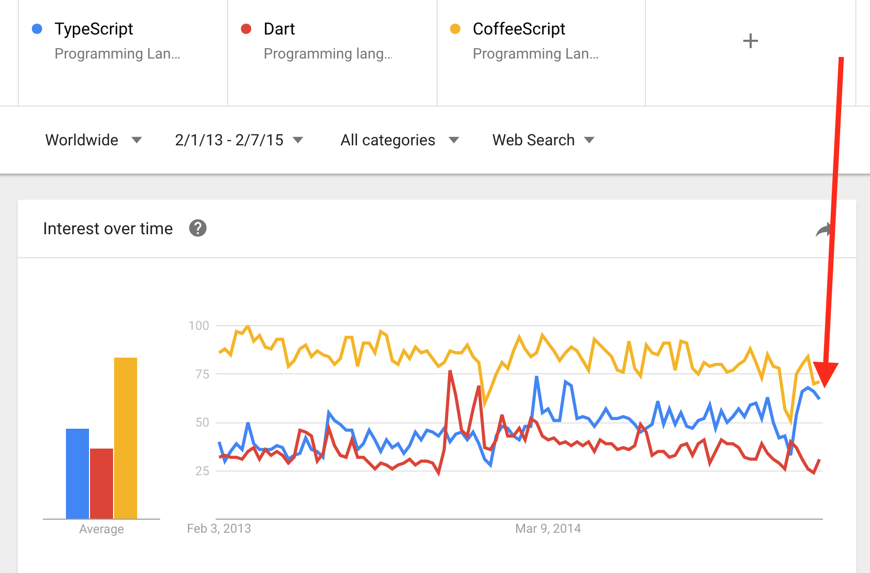

Slide 38
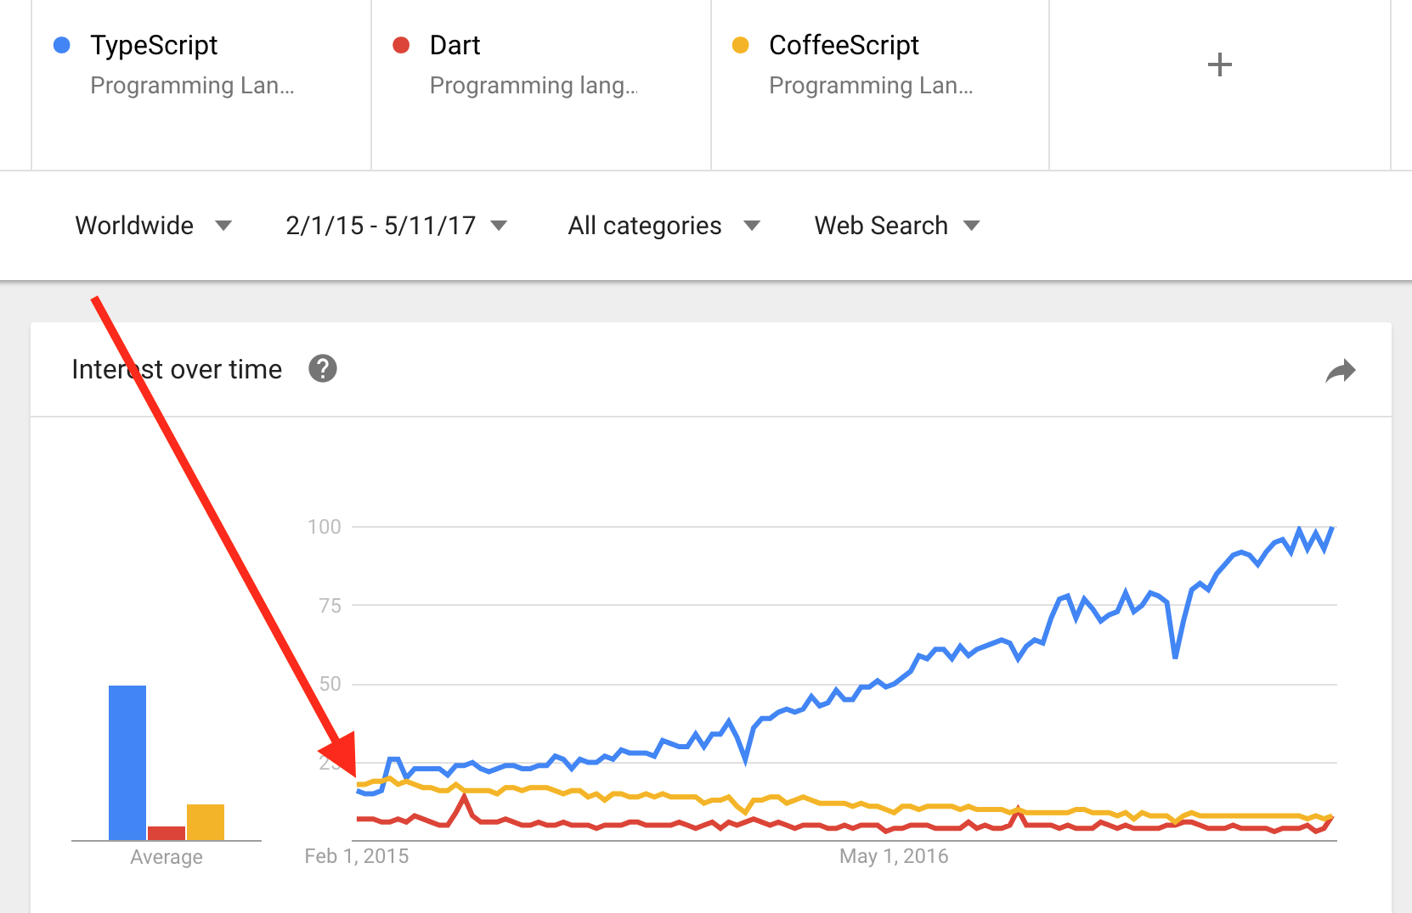

Slide 39
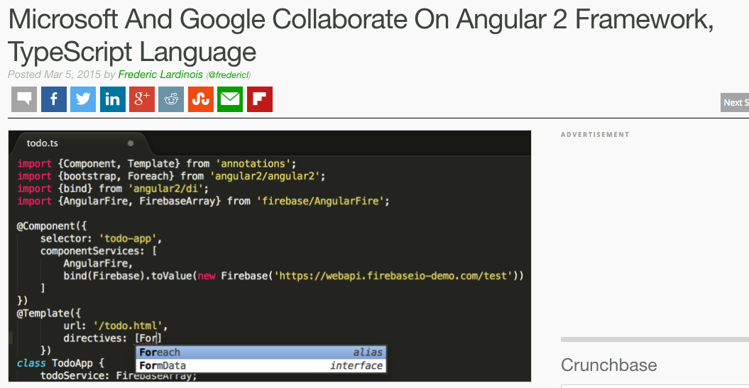

Slide 40
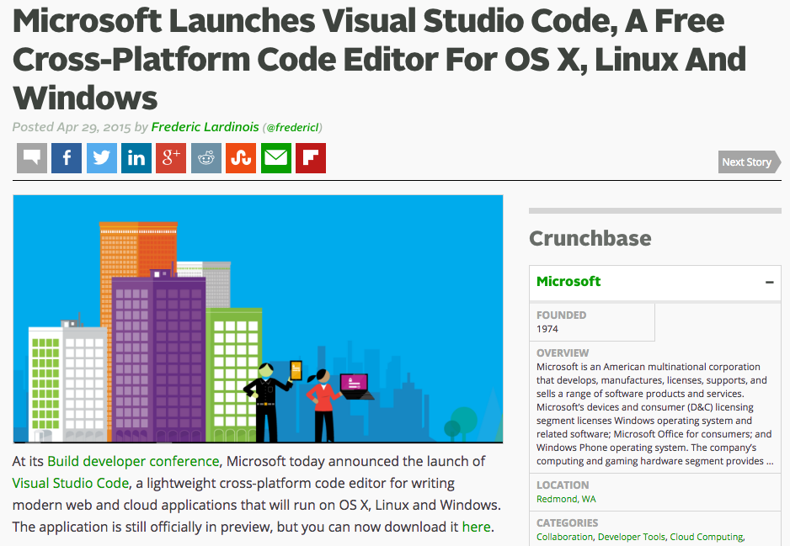

Slide 41
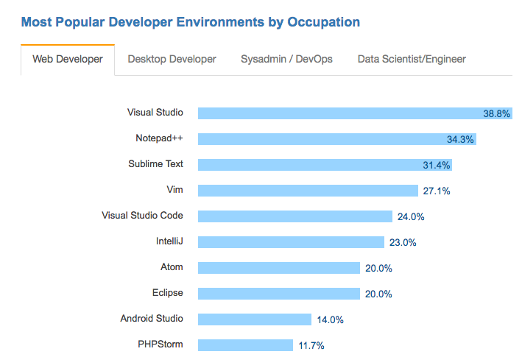

Slide 42
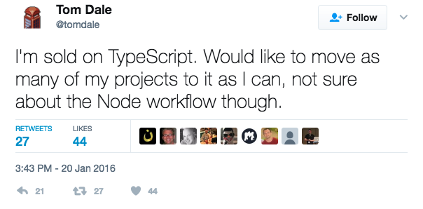

Slide 43
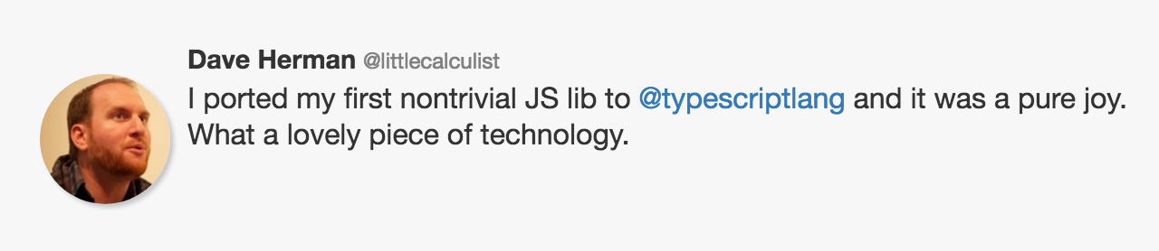

Slide 44
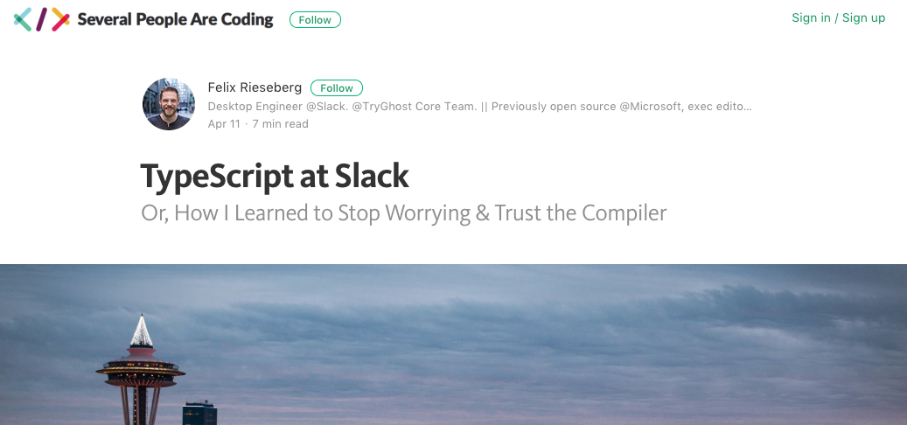

Slide 45
Why?

Slide 46
3 reasons

Slide 47
1) Commitment to the ECMAScript standard

Slide 48
“Some examples [of compile-to-JavaScript frameworks], like Dart, portend that JavaScript has fundamental flaws and to support these scenarios requires a “clean break” from JavaScript in both syntax and runtime. We disagree with this point of view. We believe that with committee participant focus, the standards runtime can be expanded and the syntactic features necessary to support JavaScript at scale can be built upon the existing JavaScript standard.”

Slide 49
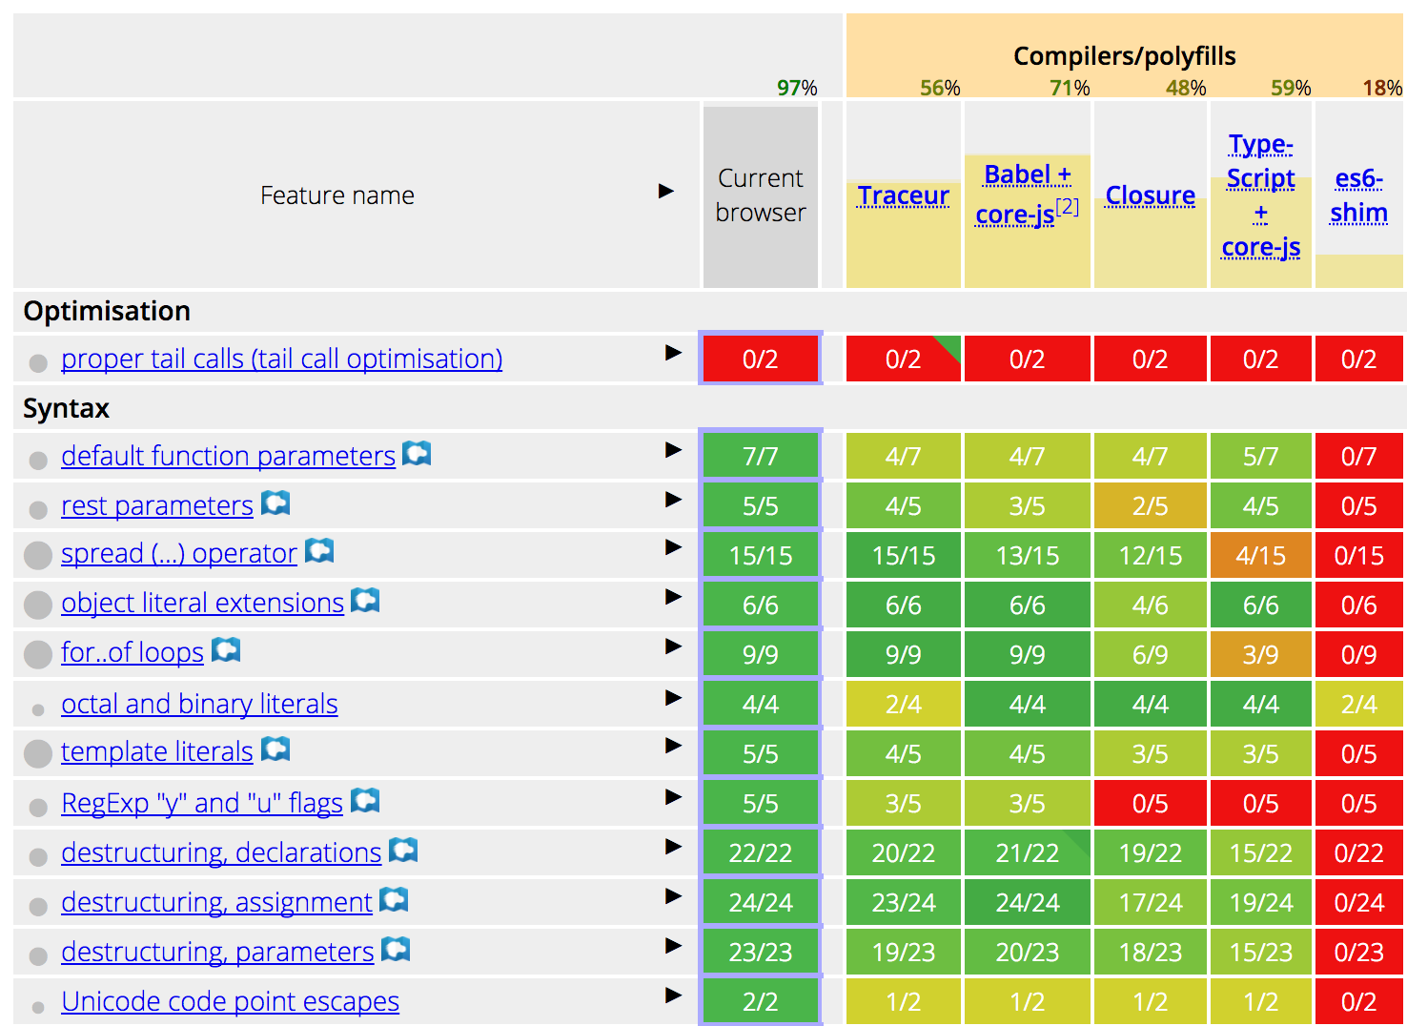

Slide 50
2) Types are opt-in

Slide 51
3) Tooling

Slide 52
So should you use TypeScript?
Are your apps big?
Do you work on a team?
Unfamiliar codebases?
Non JS developers that need to write JS code?

Slide 53
Thanks!
@tjvantoll
Notes:
Feel free to swap out the Progress logo with your own logo.

